Slide 1
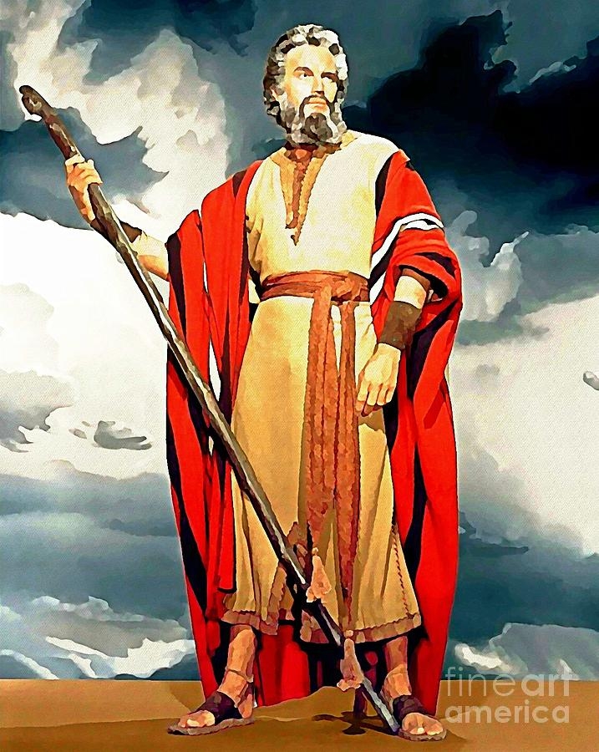
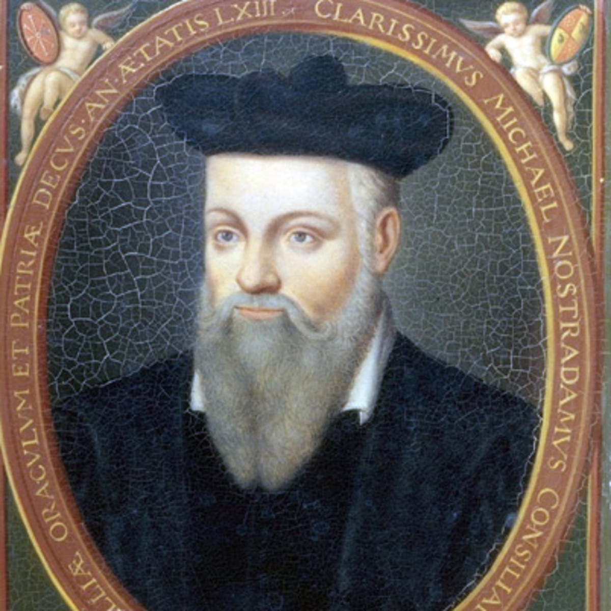

Big Data and Global Policies
Scraping Future
#jacksonbigdata soothsaying
Piotr Drzewiecki
Notes:
Photo: Amazon.com

Slide 2
Roadmap
Previous project
Current project – aim, dataset, hypothesis
The magic behind – creating dataset
Analysis results
Trivia

Slide 3

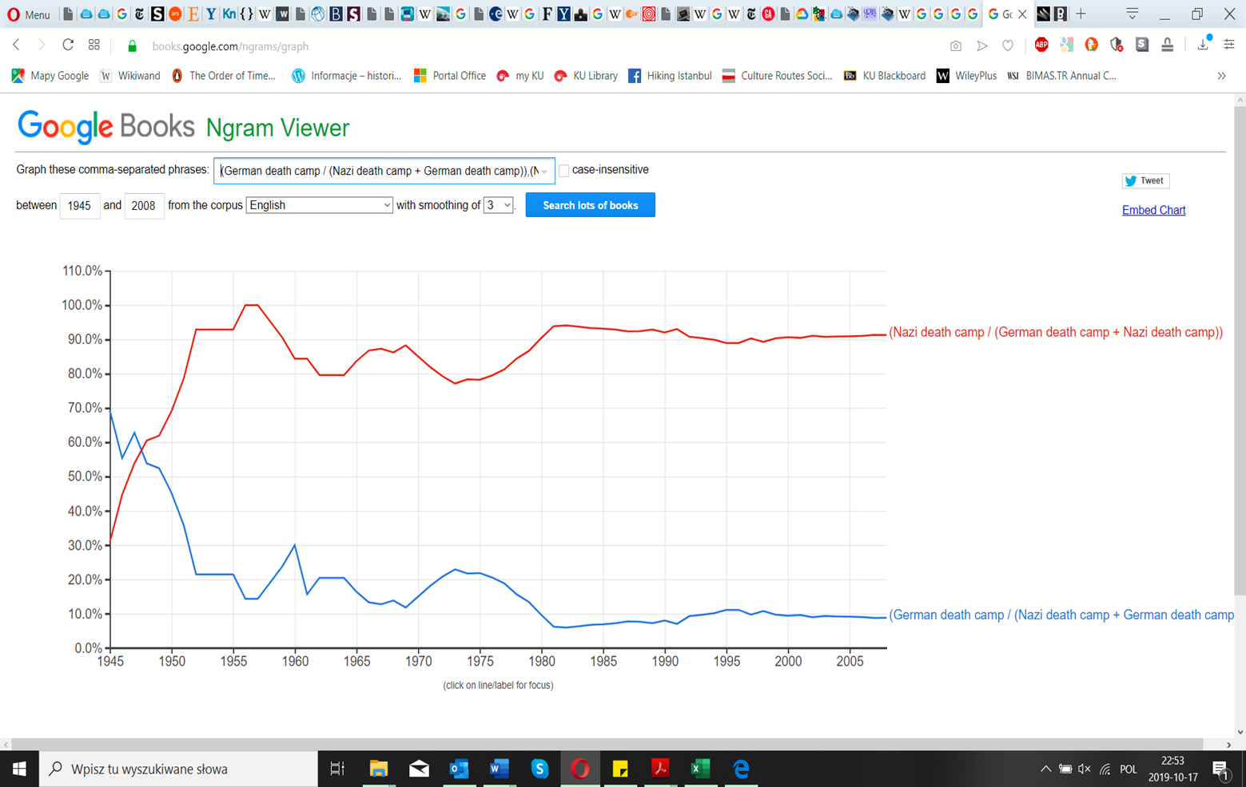
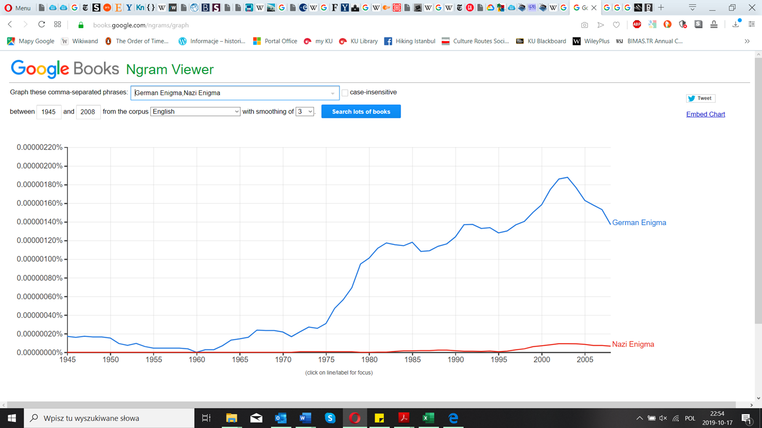
The things of the past
Notes:
4% of global turnover as maximum fine -> might also become relevant for google and facebook at some point in time
Currently not really interesting for them

Slide 4
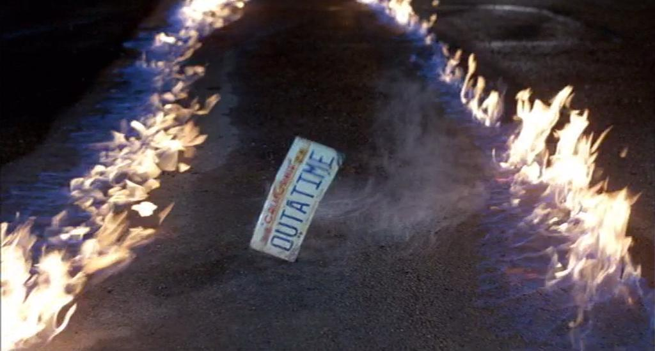
Future seen from the past
What?
Plot of all the movies about future (573 data points) – „2001: Space Odyssey” to „Zombie Strippers”
Why?
To determine what lays ahead, and what it says about us now.

Slide 5





Tools of torment
Scraping tables
Beautiful soup
Using Wikipedia API
Sentiment analysis
LIWC
Visualization
Tableau

Slide 6
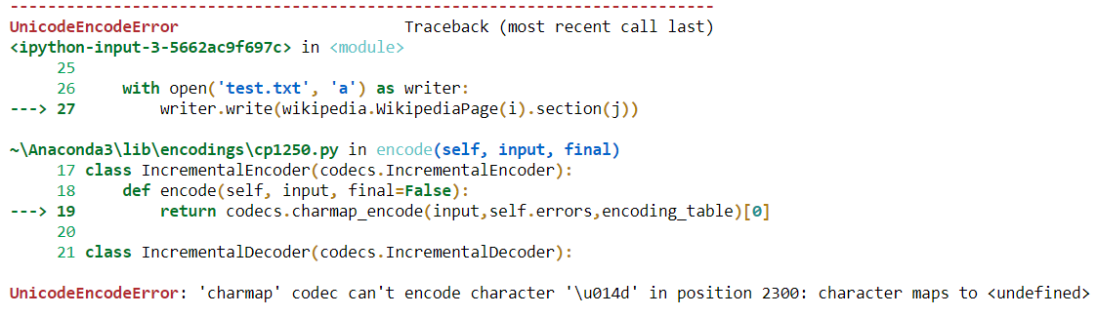
Psalm 19:12 Who can discern his own errors?
API and the tables To add or not to write
NONE results
UTF-8 – why so fancy names?
nampy is nampy

Slide 7

Hypotheses
Future is grim, because „bad news is good news”
Future is male, like 85% script writers in Hollywood
Not feasible to comment on separate authors
High Analytical score due to the nature of the text

Slide 8
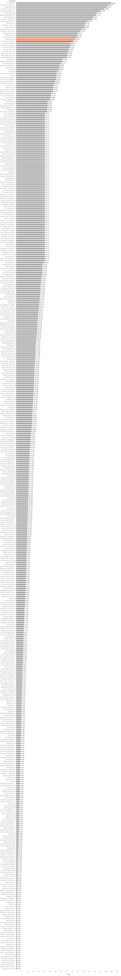
Aggregate results
Future is very grim – ‘tone’ score is only 8.61
‘Analytics’ score very high – 96.05
Future is about ‘them’ (1.32) rather than ‘us’ (0.04), and they are mostly very ‘angry’ (1.72) males

Slide 9

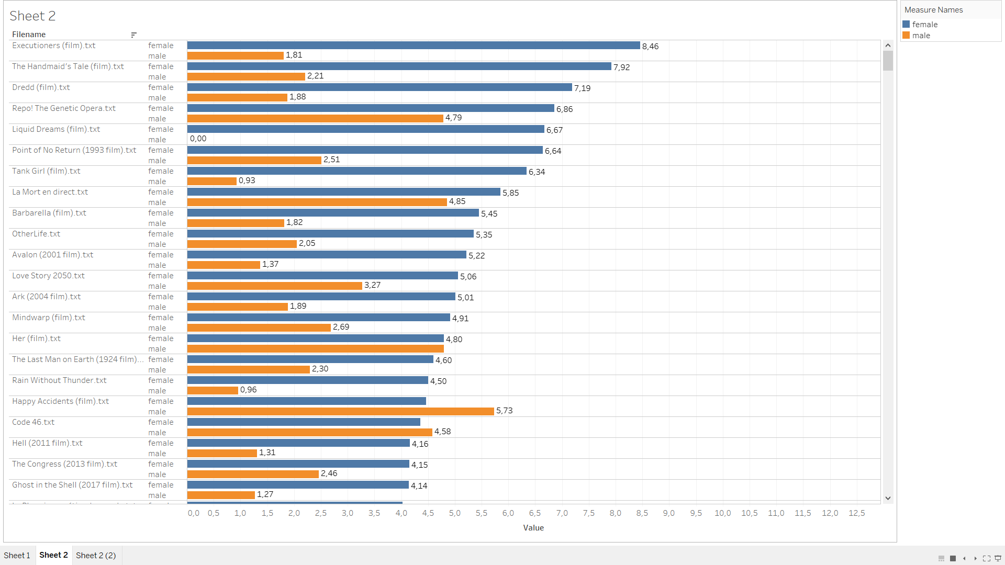

Trivia

Slide 10

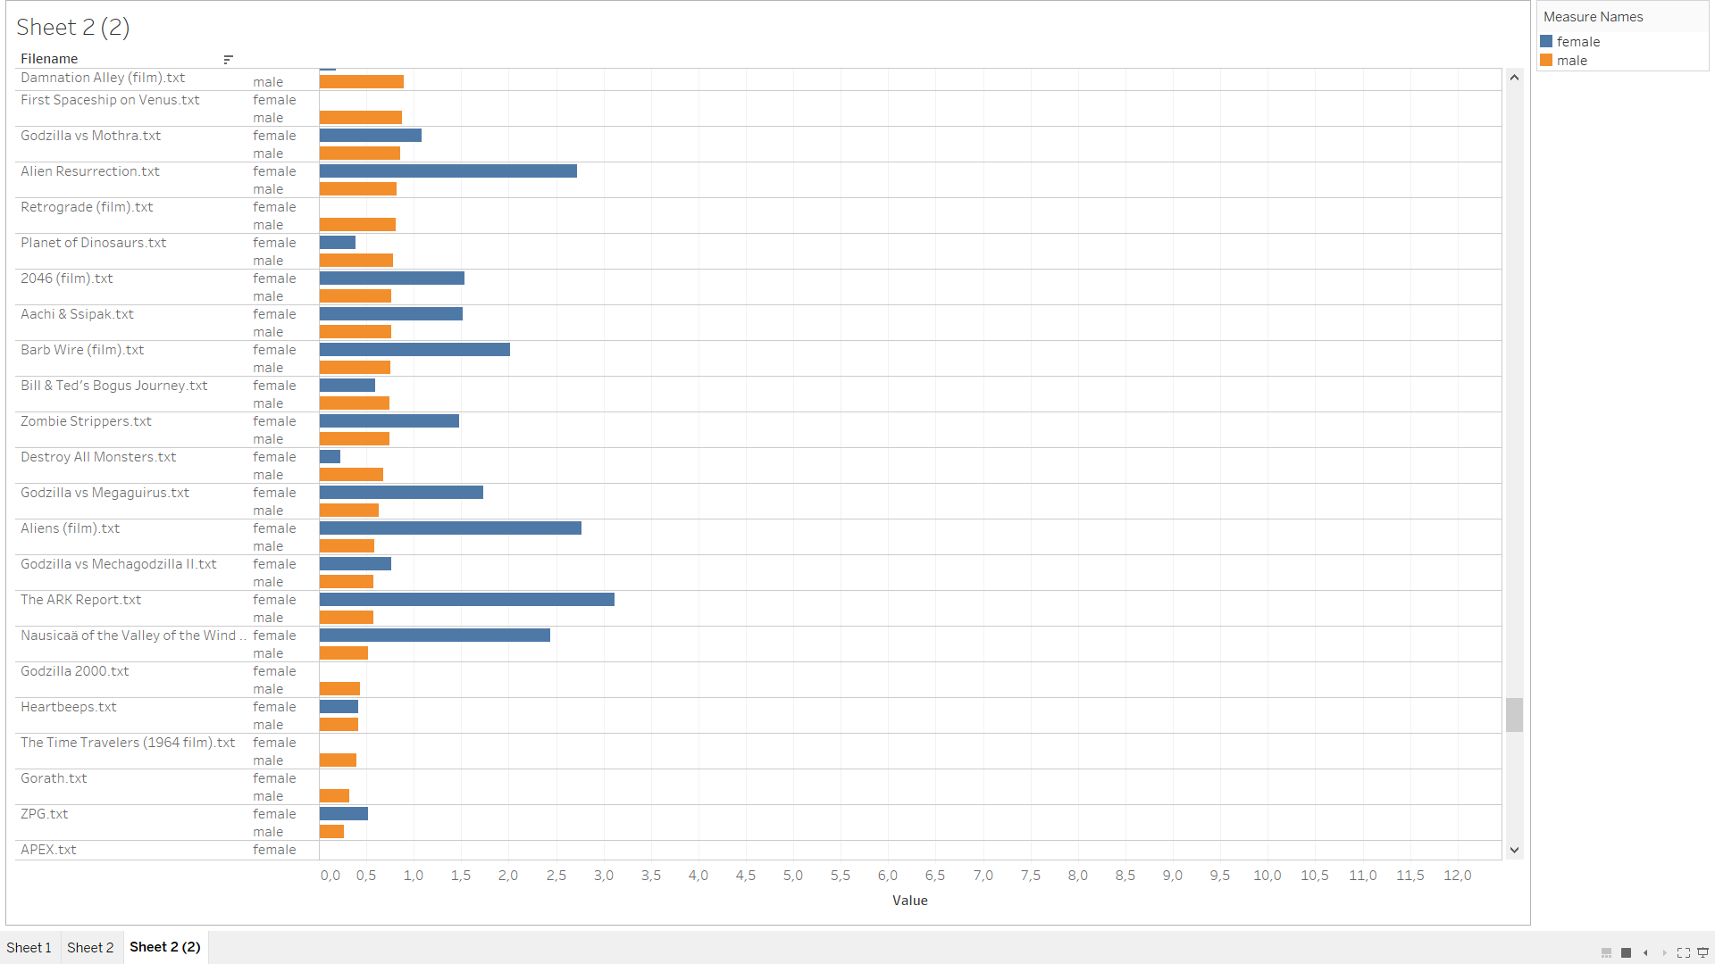

Trivia

